Slide 1
FSharp Eye For A C++ Guy
Denver C++ Group
2 July 2020
Jamie Dixon

Slide 2
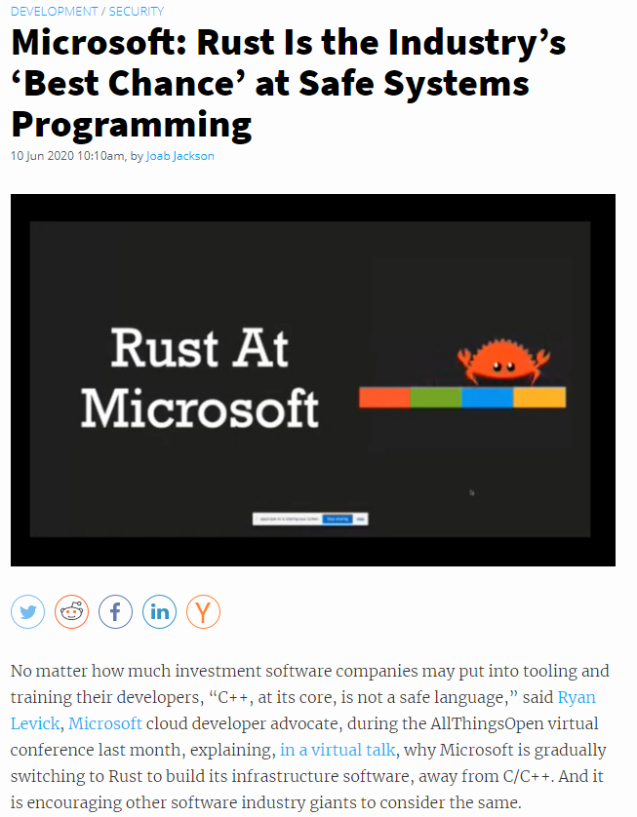
https://thenewstack.io/microsoft-rust-is-the-industrys-best-chance-at-safe-systems-programming/

Slide 3
Agenda
Concept 1: .NET Interop
Concept 2: Language Syntax
Concept 2: Type System
Concept 2: Immutability
Concept 2: High Order Functions
Concept 2: Functional Pipelines
Concept 3: ROP
Concept 4: Domain Driven Design
Concept 5: Glue Code
Argument: Terseness and Correctness
Argument: Functional > OO

Slide 4
Thank You
Questions?
jamessdixon@gmail.com
@jamie_dixon

